Slide 1
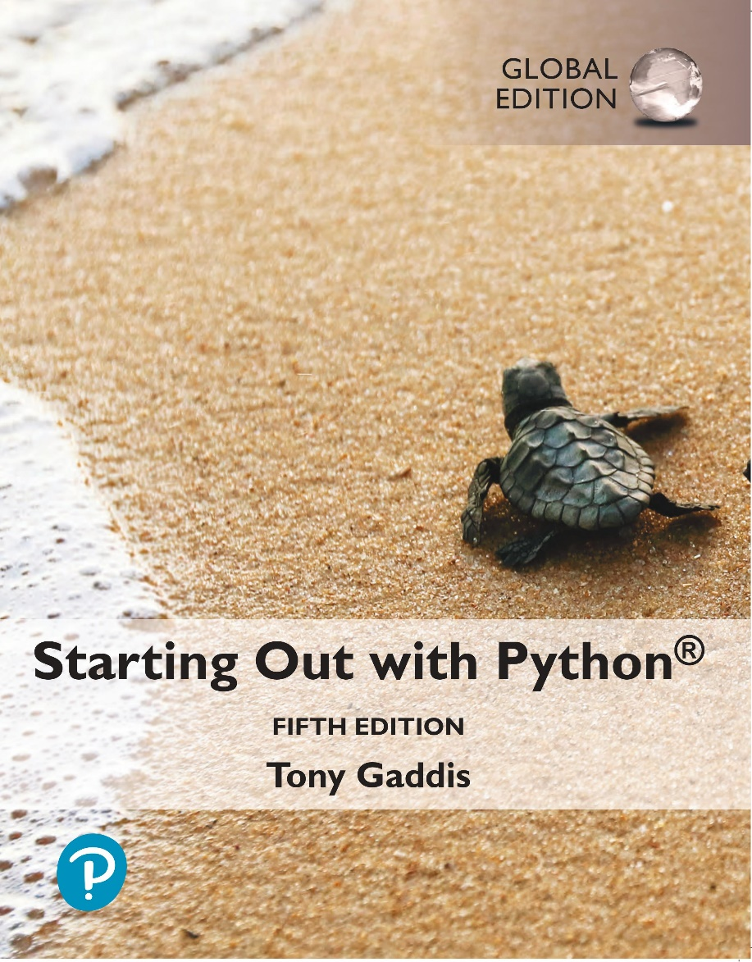
Starting out with Python
Fifth Edition, Global Edition
Chapter 4
Repetition Structures
Copyright © 2022 Pearson Education, Ltd. All Rights Reserved.

Slide 2
Topics
Introduction to Repetition Structures
The while Loop: a Condition-Controlled Loop
The for Loop: a Count-Controlled Loop
Calculating a Running Total
Sentinels

Slide 3
Introduction to Repetition Structures
Often have to write code that performs the same task multiple times
Disadvantages to duplicating code
Makes program large
Time consuming
May need to be corrected in many places
Repetition structure: makes computer repeat included code as necessary
Includes condition-controlled loops and count-controlled loops

Slide 4
The while Loop: a Condition-Controlled Loop (1 of 4)
while loop: while condition is true, do something
Two parts:
Condition tested for true or false value
Statements repeated as long as condition is true
In flow chart, line goes back to previous part
General format:
while condition:
statements

Slide 5
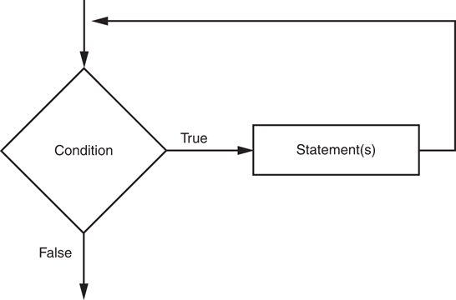
The while Loop: a Condition-Controlled Loop (2 of 4)
Figure 4-1 The logic of a while loop

Slide 6
The while Loop: a Condition-Controlled Loop (3 of 4)
In order for a loop to stop executing, something has to happen inside the loop to make the condition false
Iteration: one execution of the body of a loop
while loop is known as a pretest loop
Tests condition before performing an iteration
Will never execute if condition is false to start with
Requires performing some steps prior to the loop

Slide 7
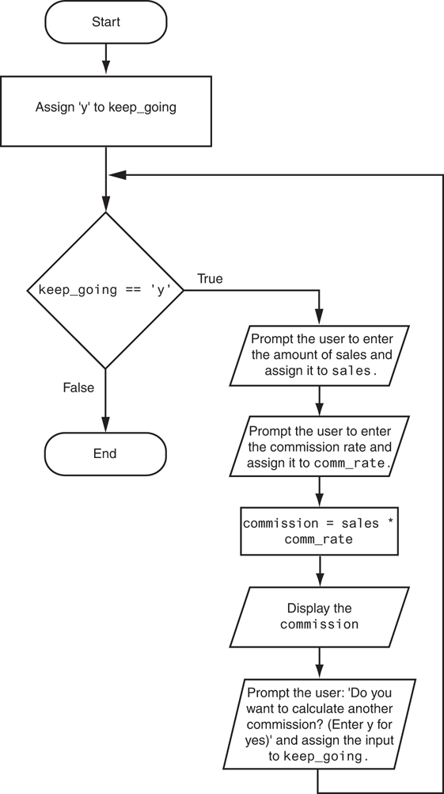
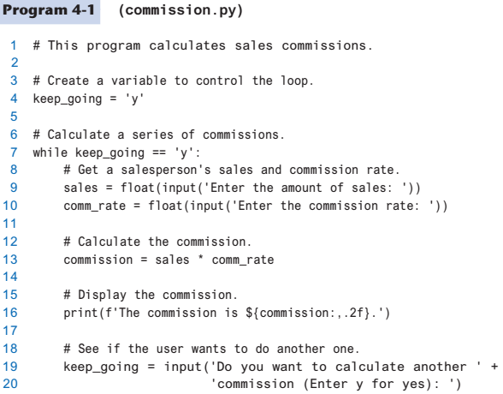
The while Loop: a Condition-Controlled Loop (4 of 4)
Figure 4-3 Flowchart for Program 4-1

Slide 8
Örnek
Soru: Girilen 2 tamsayının OBEB’ini bulan algoritma:

Slide 9
Infinite Loops (1 of 2)
Loops must contain within themselves a way to terminate
Something inside a while loop must eventually make the condition false
Infinite loop: loop that does not have a way of stopping
Repeats until program is interrupted
Occurs when programmer forgets to include stopping code in the loop

Slide 10
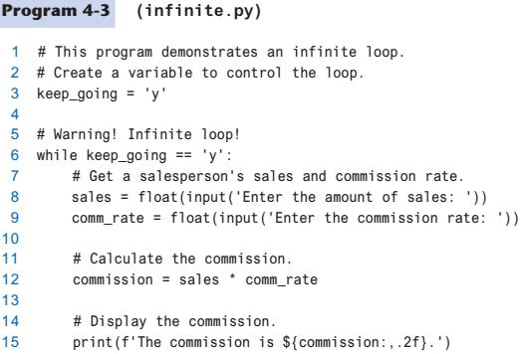
Infinite Loops (2 of 2)

Slide 11
The for Loop: a Count-Controlled Loop (1 of 2)
Count-Controlled loop: iterates a specific number of times
Use a for statement to write count-controlled loop
Designed to work with sequence of data items
Iterates once for each item in the sequence
General format:
for variable in [val1, val2, etc]:
statements
Target variable: the variable which is the target of the assignment at the beginning of each iteration

Slide 12
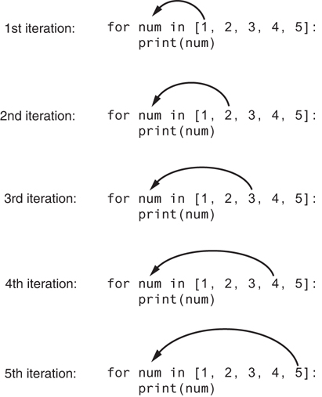
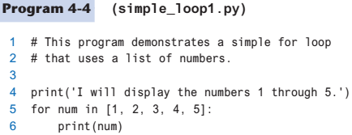
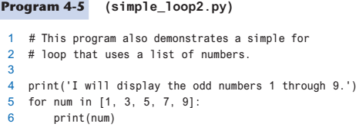
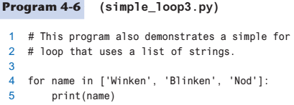
The for Loop: a Count-Controlled Loop (2 of 2)
Figure 4-4 The for loop

Slide 13
Using the range Function with the for Loop
The range function simplifies the process of writing a for loop
range returns an iterable object
Iterable: contains a sequence of values that can be iterated over
range characteristics:
One argument: used as ending limit
Two arguments: starting value and ending limit
Three arguments: third argument is step value

Slide 14
Using the Target Variable Inside the Loop (1 of 2)
Purpose of target variable is to reference each item in a sequence as the loop iterates
Target variable can be used in calculations or tasks in the body of the loop
Example: calculate square root of each number in a range

Slide 15
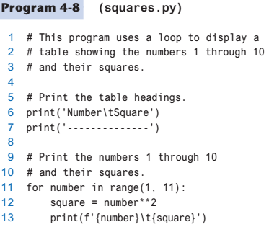
Using the Target Variable Inside the Loop (2 of 2)

Slide 16
Letting the User Control the Loop Iterations (1 of 2)
Sometimes the programmer does not know exactly how many times the loop will execute
Can receive range inputs from the user, place them in variables, and call the range function in the for clause using these variables
Be sure to consider the end cases: range does not include the ending limit

Slide 17
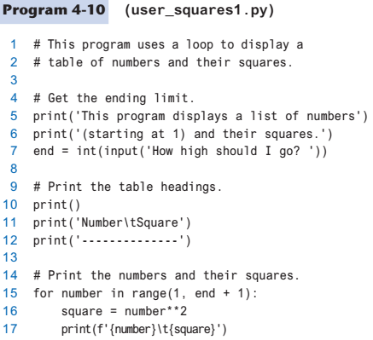
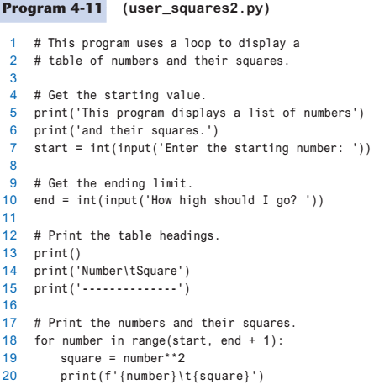
Letting the User Control the Loop Iterations (2 of 2)

Slide 18
Örnek
Soru: Sınıftaki öğrenci sayısını ve her öğrencinin arasınav ve final notlarını alan, her öğrencinin dönem sonu notunu ve başarı durumunu (geçme notu 60 ve arasınav %40, final %60 etkili) yazdıran algoritma:

Slide 19
Generating an Iterable Sequence that Ranges from Highest to Lowest
The range function can be used to generate a sequence with numbers in descending order
Make sure starting number is larger than end limit, and step value is negative
Example: range(10, 0, -1)

Slide 20
Calculating a Running Total (1 of 3)
Programs often need to calculate a total of a series of numbers
Typically include two elements:
A loop that reads each number in series
An accumulator variable
Known as program that keeps a running total: accumulates total and reads in series
At end of loop, accumulator will reference the total

Slide 21
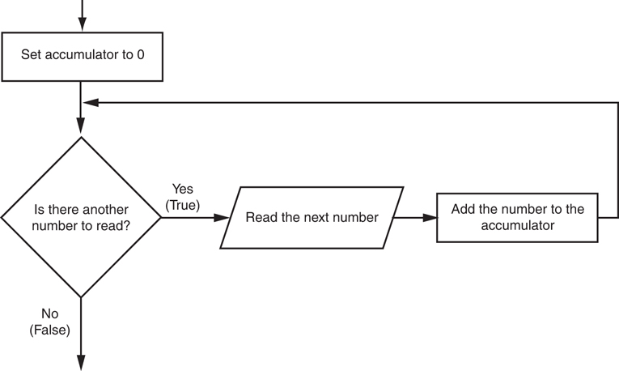
Calculating a Running Total (2 of 3)
Figure 4-6 Logic for calculating a running total

Slide 22
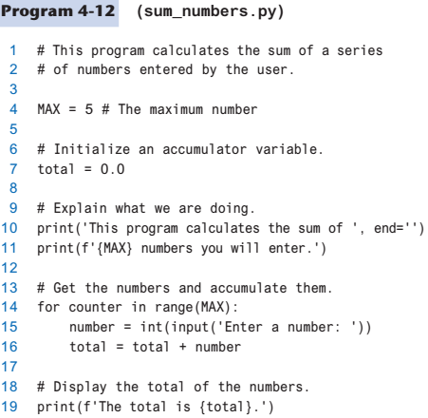
Calculating a Running Total (3 of 3)

Slide 23
Örnek
Soru: Girilen bir sayının girilen bir kuvvetini/üssünü bulan algoritma:

Slide 24
Örnek
Soru: Fibonacci sayısı kendisinden önceki iki Fibonacci sayısı toplanarak bulunur (1. ve 2. Fibonacci sayıları 1’dir). N. Fibonacci sayısını bulan algoritma:

Slide 25
The Augmented Assignment Operators (1 of 2)
In many assignment statements, the variable on the left side of the = operator also appears on the right side of the = operator
Augmented assignment operators: special set of operators designed for this type of job
Shorthand operators

Slide 26
The Augmented Assignment Operators (2 of 2)
Table 4-2 Augmented assignment operators
Operator | Example Usage | Equivalent To
+= | x += 5 | x = x + 5
−= | y −= 2 | y = y − 2
*= | z *= 10 | z = z * 10
/= | a /= b | a = a / b
%= | c %= 3 | c = c % 3
//= | x //= 3 | x = x // 3
**= | y **= 2 | y = y**2

Slide 27
Örnek
Soru: [0-100] arasındaki çift sayıların toplamını bulan algoritma:

Slide 28
Örnek
Soru: Girilen bir sayının faktöriyelini bulan algoritma:

Slide 29
Sentinels (1 of 2)
Sentinel: special value that marks the end of a sequence of items
When program reaches a sentinel, it knows that the end of the sequence of items was reached, and the loop terminates
Must be distinctive enough so as not to be mistaken for a regular value in the sequence
Example: when reading an input file, empty line can be used as a sentinel

Slide 30
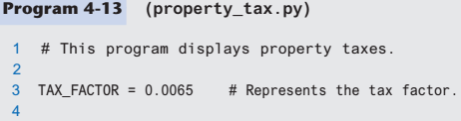
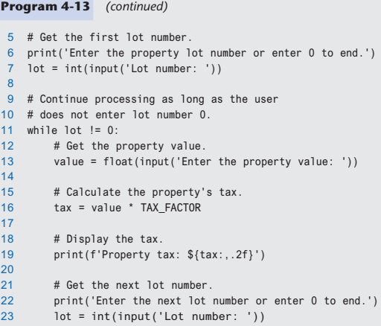
Sentinels (2 of 2)

Slide 31
Örnek
Soru: Bir dersi alan öğrencilerin notlarını alan (veri sonu için -1) ve derse ilişkin sınıf not ortalamasını, başarılı öğrenci sayısını (geçme notu 60) ve başarı yüzdesini bulan algoritma:

Slide 32
Summary
This chapter covered:
Repetition structures, including:
Condition-controlled loops
Count-controlled loops
Infinite loops and how they can be avoided
range function as used in for loops
Calculating a running total and augmented assignment operators
Use of sentinels to terminate loops

